Slide 1
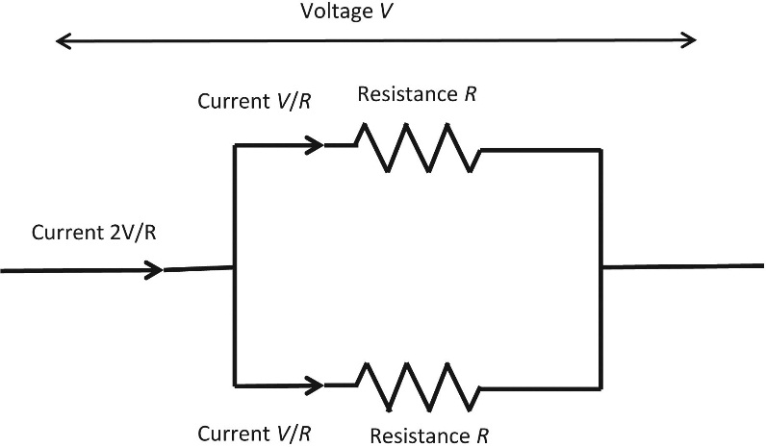
FIGURE 6.1 Resistances in Parallel

Slide 2
FIGURE 6.2 Schematic Diagram of a Capacitor

Slide 3
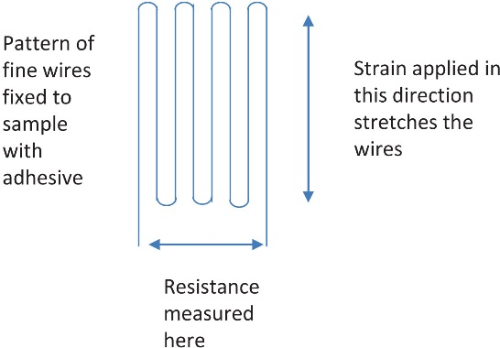
FIGURE 6.3 Schematic Diagram of a Strain Gauge

Slide 4
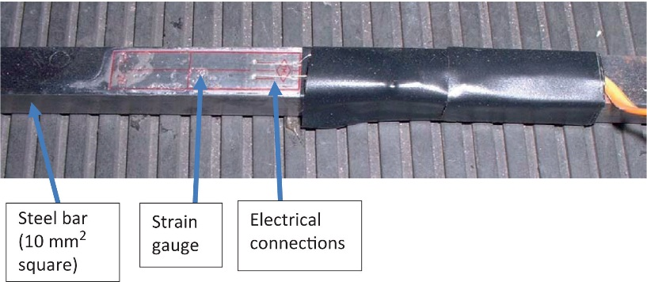
FIGURE 6.4 A Steel Bar With a Strain Gauge on it

Slide 5
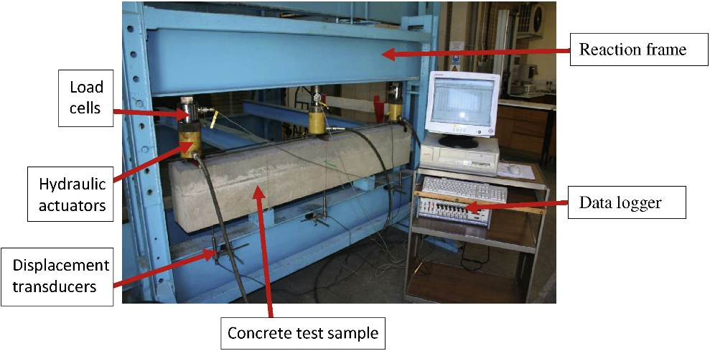
FIGURE 6.5 Testing a Concrete Beam

Slide 6
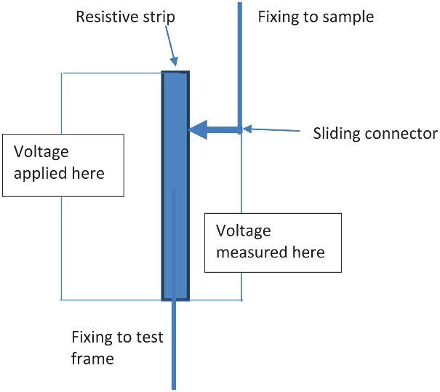
FIGURE 6.6 Schematic Diagram of Potentiometer Displacement Transducer

